Slide 1
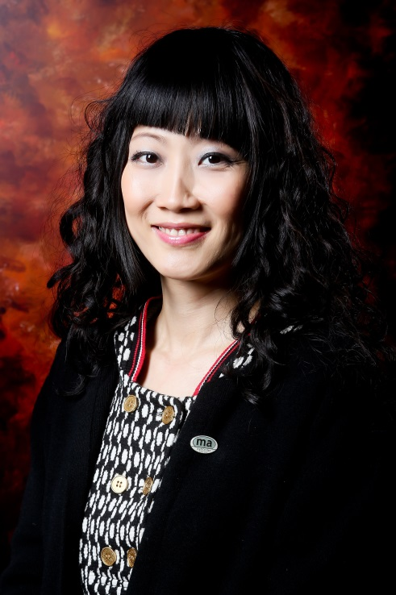
網路中心開拓無限盈利潛力
The Profitable Possibilities with WebCenter
Frances Siu
專業經理級 Professional Coordinator
四個佣金週期共賺取HK$34,500
HK$34,500 in 4 Commission weeks
本簡報中提到的收入等級純屬舉例說明，無意代表美安香港超連鎖™店主的一般收入，也無意表示任何超連鎖™店主皆可賺取同等收入。美安香港超連鎖™店主的成功與否，取決於其在發展事業時的努力、才能與投入程度。The income levels mentioned in the following presentation are for illustration purposes only. They are not intended to represent the income of a typical Market Hong Kong UnFranchise ™Owner, nor are they intended to represent that any given Independent UnFranchise ™ Owner will earn income in that amount. The success of any Market Hong Kong Independent UnFranchise ™ Owner will depend upon the amount of hard work, talent, and dedication which he or she devotes to building his or her Market Hong Kong Business.

Slide 2
新產品 新願景 新商機
New Product New Vision
New Opportunity

Slide 3
市場趨勢
行動上網
83.8%家庭有固網寬頻服務 Family with broadband
Market Trend
Mobile online
1千4百萬手機3G/4G用戶14 Million mobile 3G/4G users
2014年3G/4G資訊使用量是2013年的1.35倍，2012年的2.26 倍
2014 there is a growth of 1.35 times in the mobile data usage over the same period in 2013 and 2.26 times over the same period in 2012
整體家庭固網滲透率94.89% (2015年12月）
整體手機滲透率228.5%(2015年12月）
Residential fixed line penetration rate (Dec. 2015) 94.89%
Mobile subscriber penetration rate (Dec. 2015 )228.5%
資料來源: OFTA香港政府
http://www.ofca.gov.hk/en/media_focus/data_statistics/key_stat/
http://www.gov.hk/en/about/abouthk/factsheets/docs/telecommunications.pdf

Slide 4
每個企業主都需要:
Every Business Owner needs:
線上解決方案
Online solution
網頁設計
社群媒體
電子郵件
GOOGLE
手機網站
電子郵件行銷
好的行銷內容
電子商務
安全性
支援
維護
Web Design
Social Media
e-mail
GOOGLE
mobile site
emarketing
marketing content
ecommerce
security
Support
Maintenance

Slide 5
我們提供絕佳的
解決方案
We Provide the
best solution
簡單明瞭 Straight forward
專業
Professional
經濟實惠
Economy
可方便維護
Easy to maintain
全站式服務
Total solution
安全性
Secure
支援
Support
合作夥伴關係
Partnership

Slide 6
我們幫助中小型企業:
We help SME:
增加利潤 Increase revenue
降低成本 Lower the cost
增加客戶滿意度
Increase customer satisfaction
進行線上行銷活動
Execute online marketing activities

Slide 7
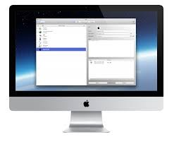
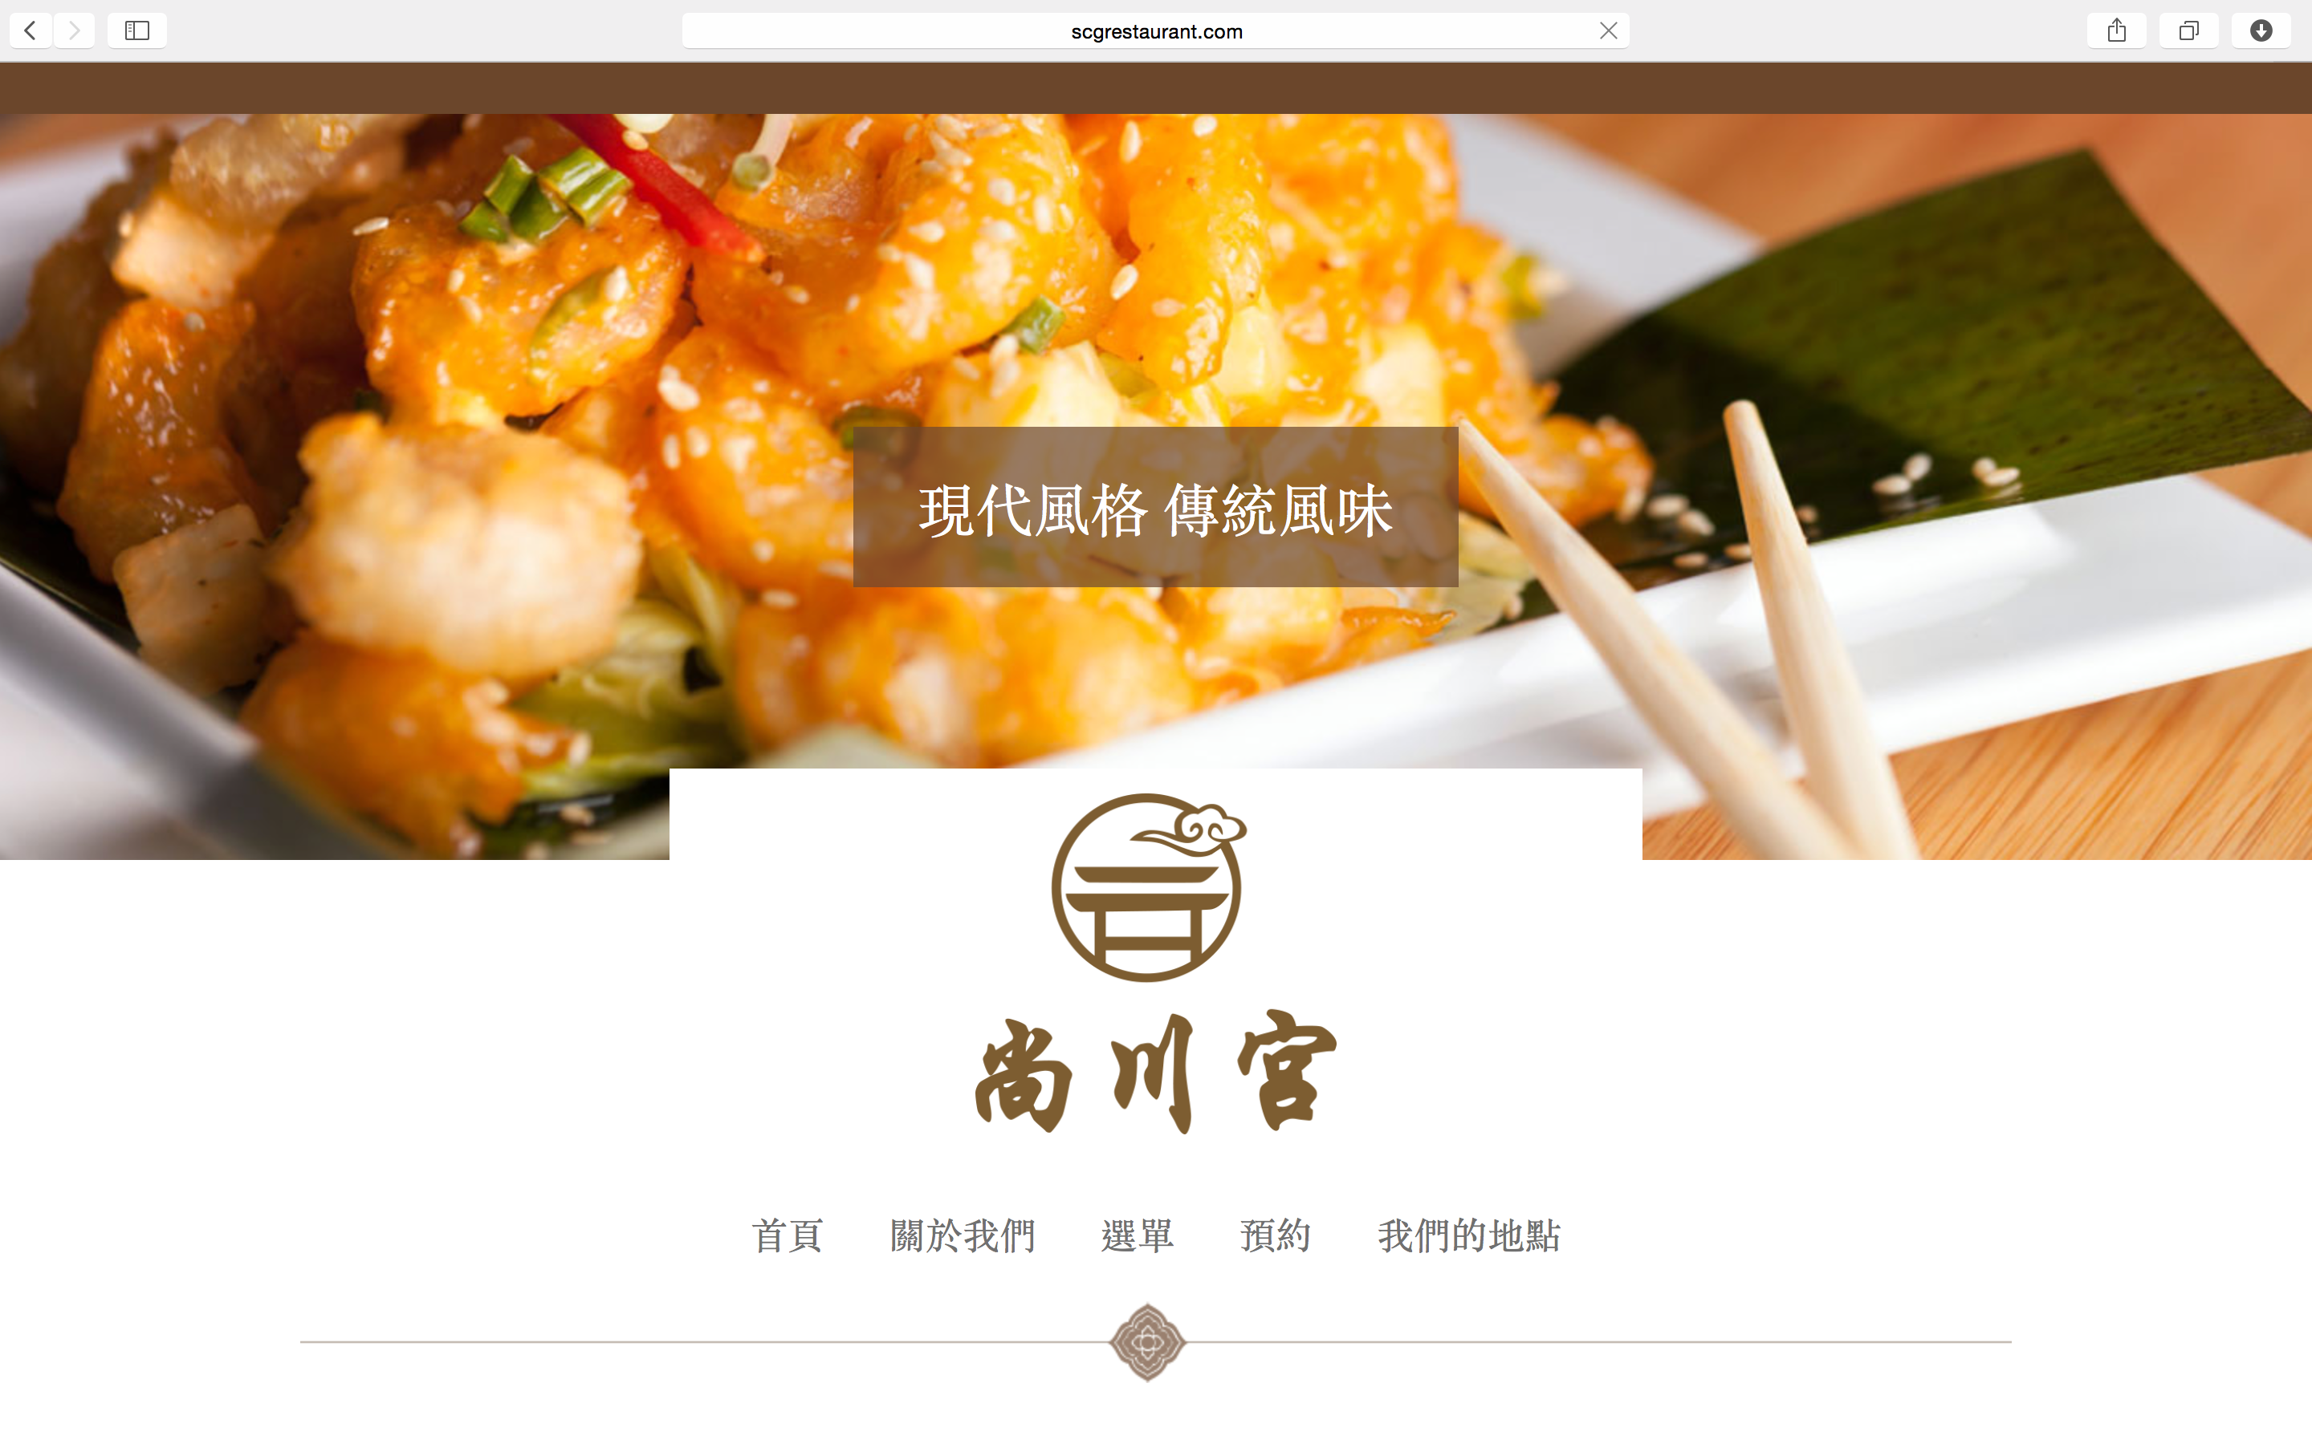
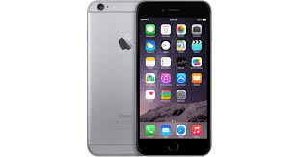
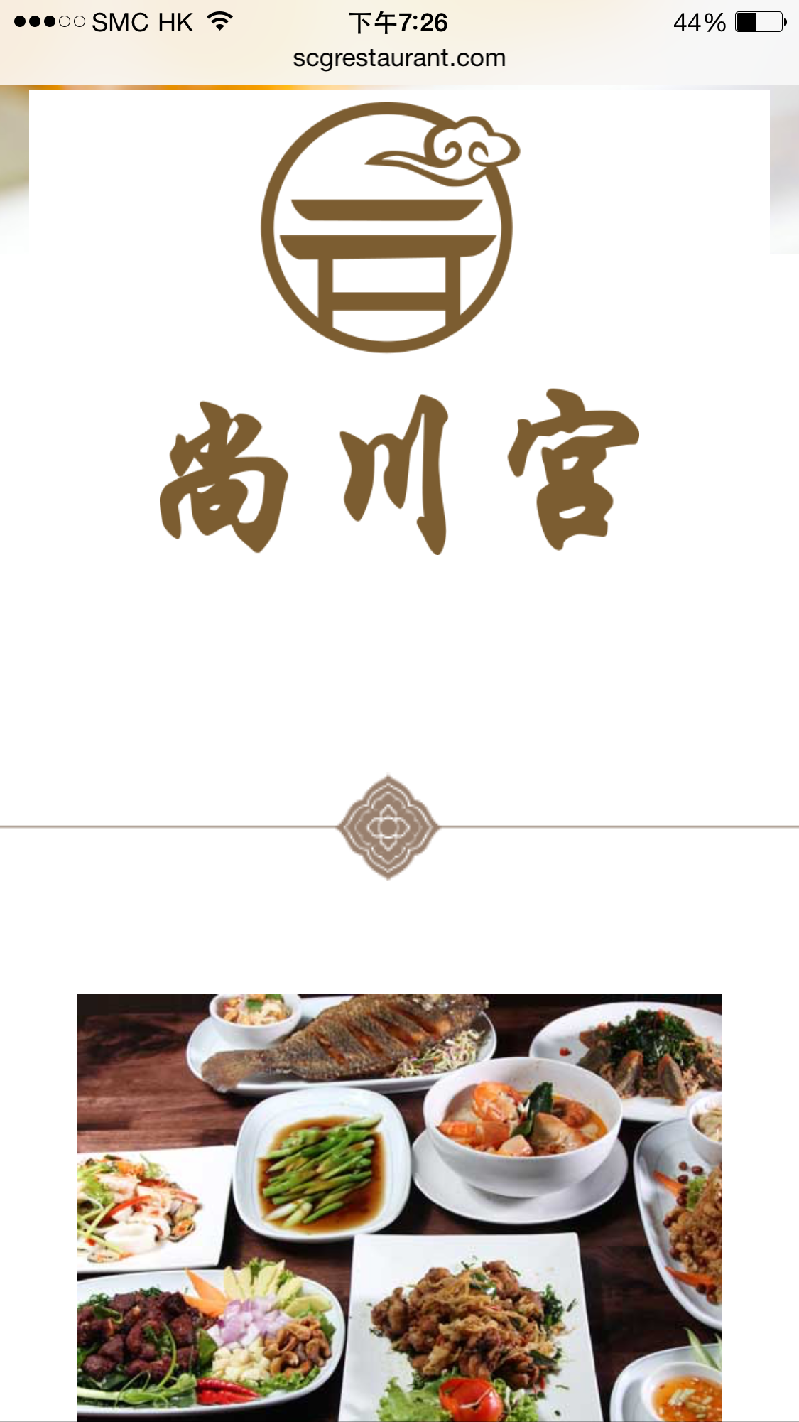
我們的
解決方案
Our solution
加盟夥伴商店兩個月已帶來HK$45,000的利潤
Partner Store has HK$45,000 revenue in two months
專業 Professional
可方便維護 Easy to Maintain
合作夥伴關係 Partnership

Slide 8
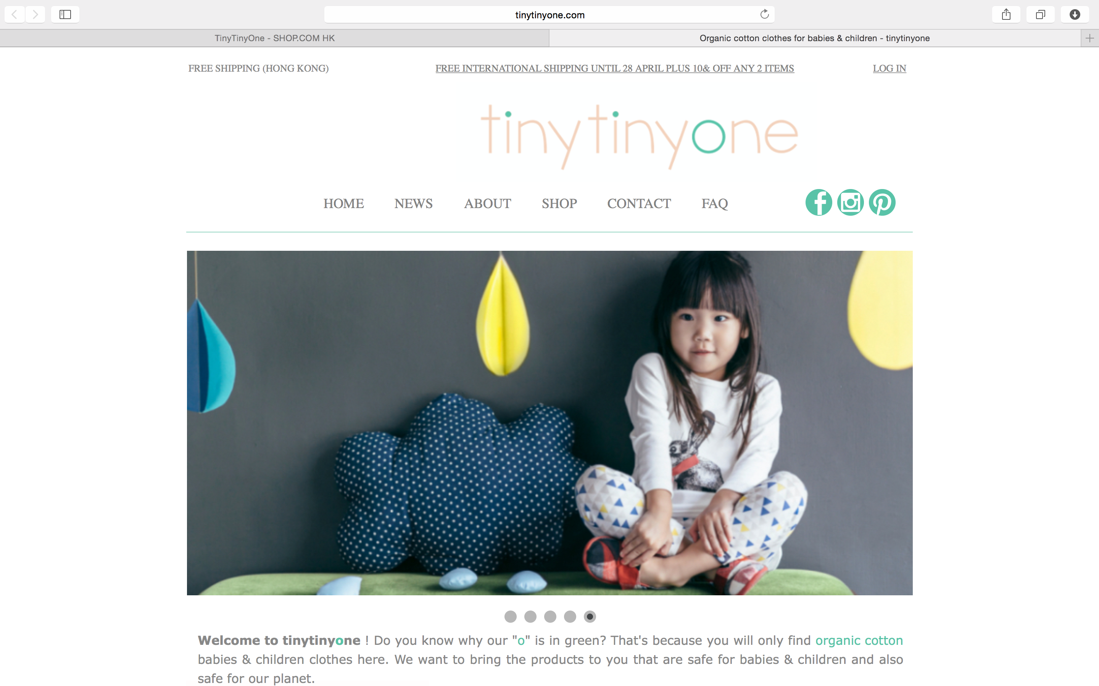
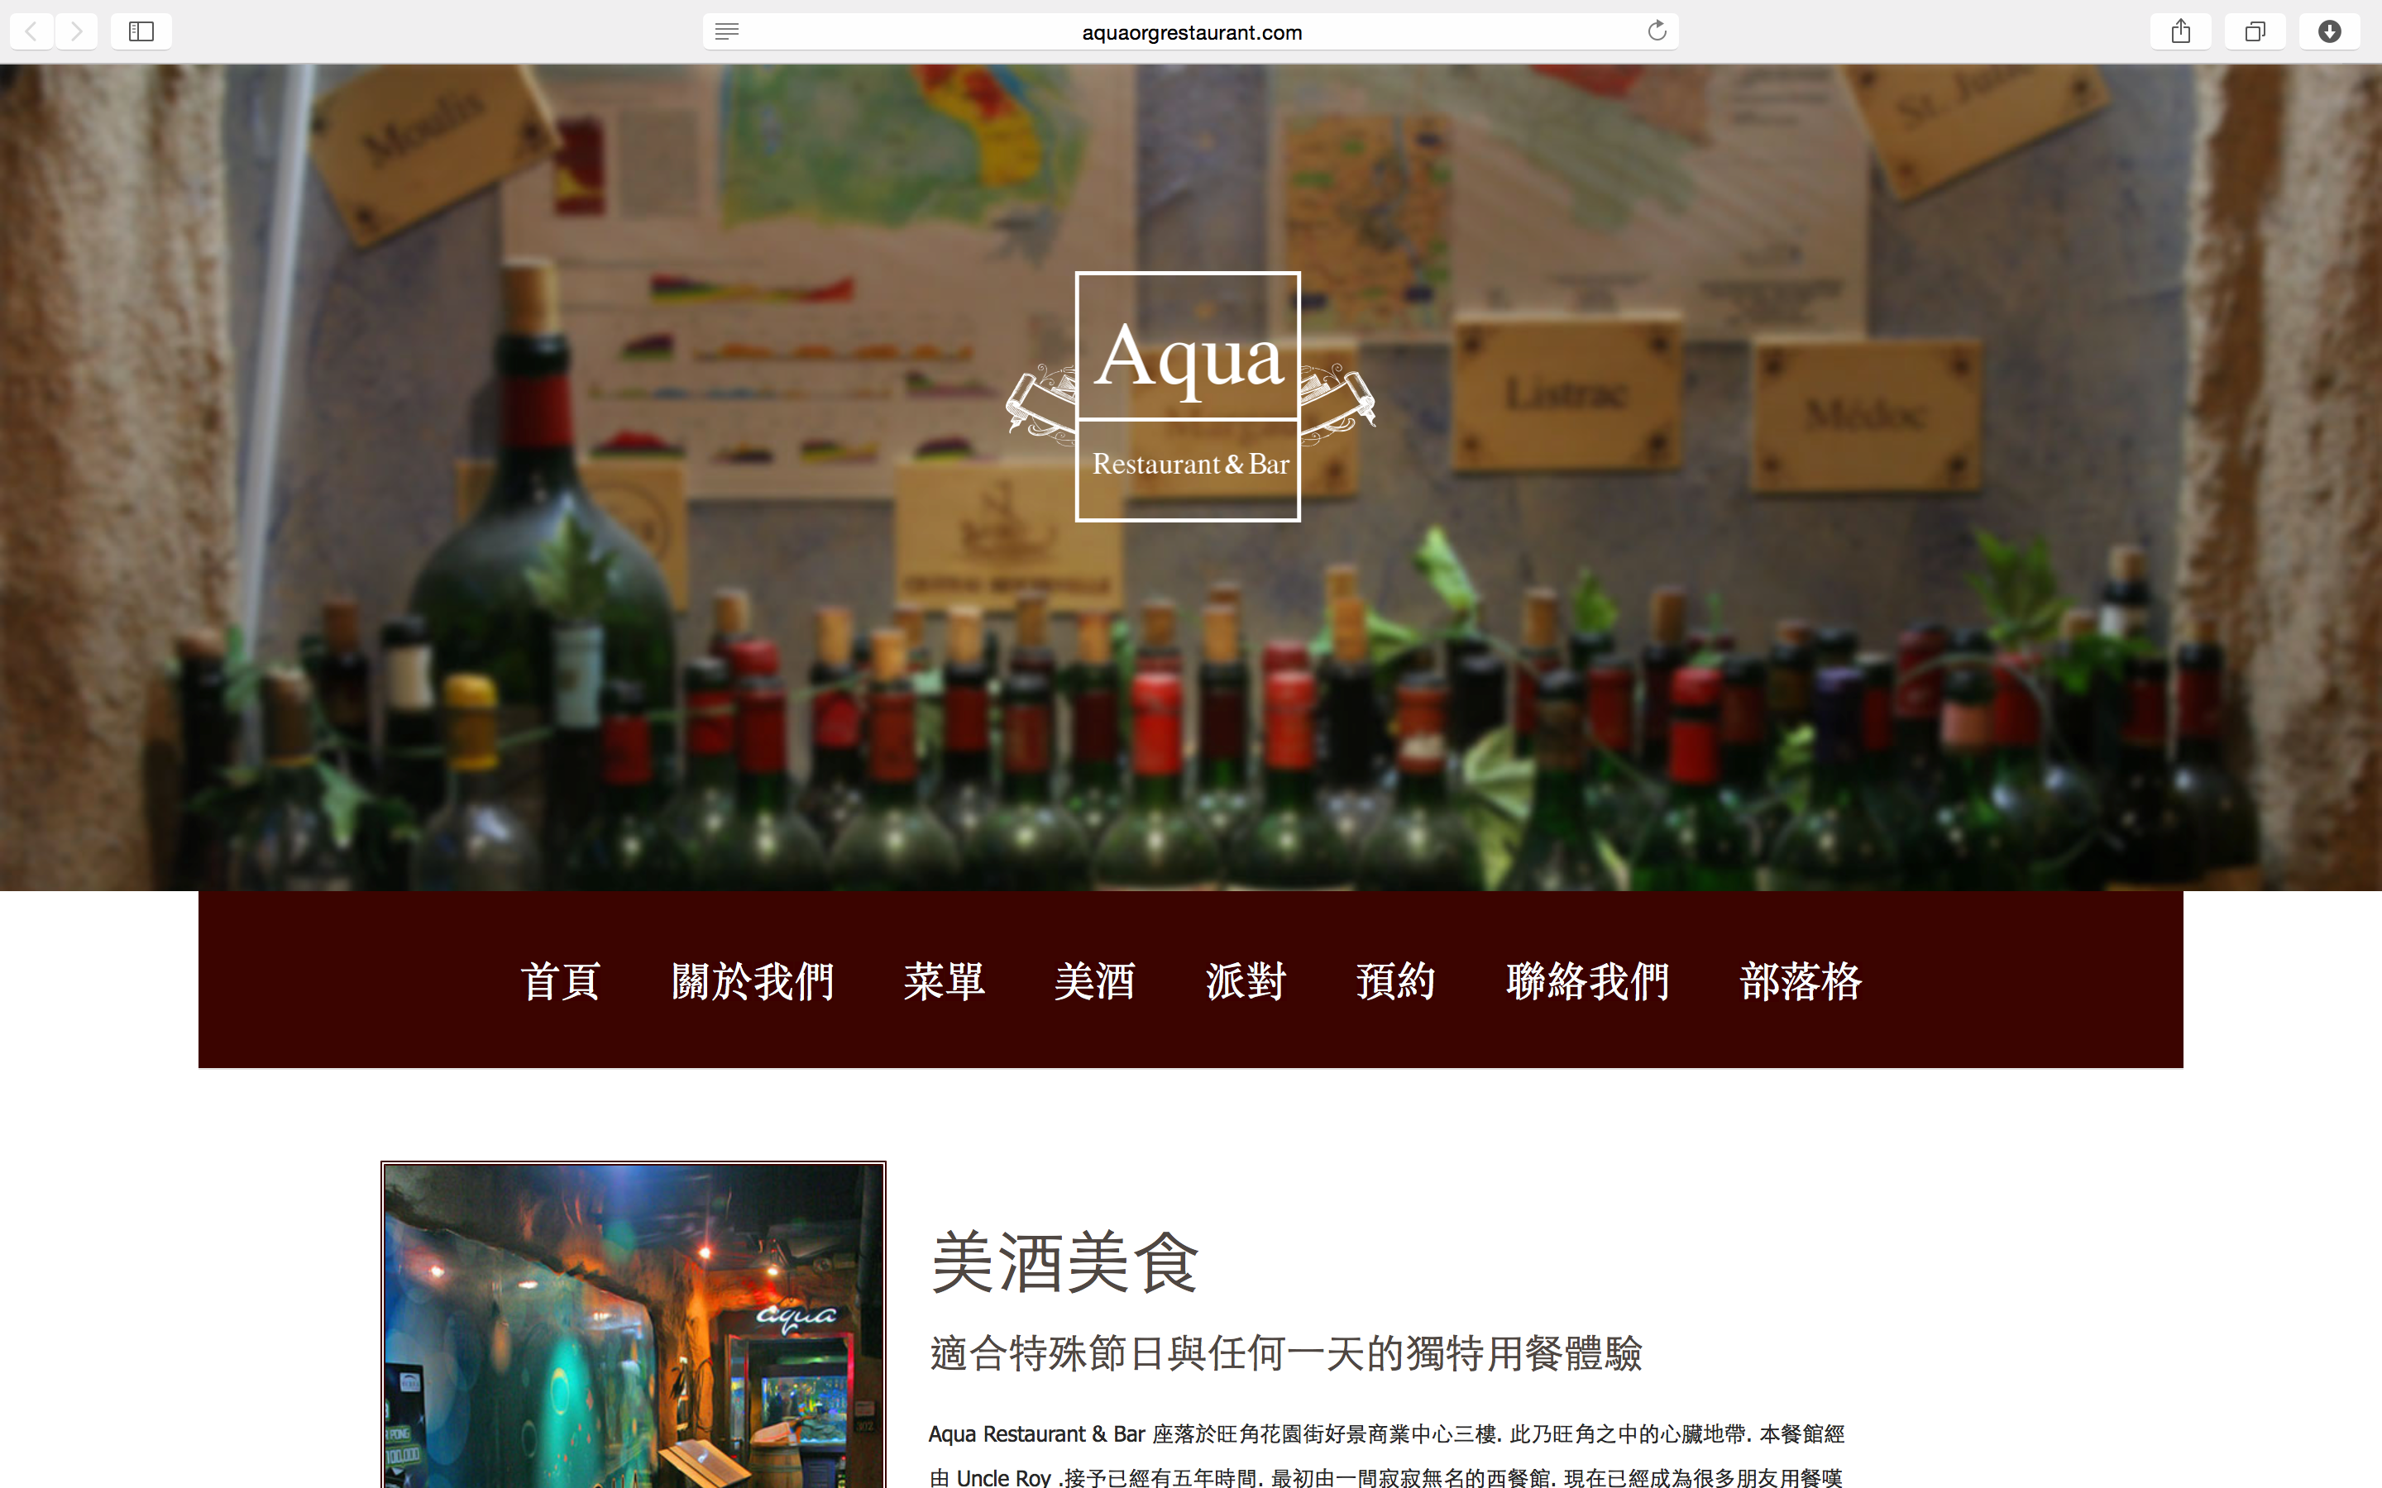

Slide 9
平均網站銷售費用為HK$10,100
The average website sale is
HK$10,100
這樣就能賺取HK$7,800的
零售利潤﹗That generates about
HK$7,800 retail profit!
帶著你的目標，算一算是HK$7,800的幾倍，這樣你就知道該賣掉幾個網站，就能達成目標
Take your goals, break them down into HK$7,800 increments to get an estimate of how many website sales you’d need to make to achieve those goals
Notes:
TRAINER’S NOTES:
Again – you can apply this to any of your fixed cost goals

Slide 10
每賣出一個網站，
可得230業績點數(BV)
Each website sold
generates 230 BV
保有一位活躍客戶，
每個月就可賺取30 BV
Each active client
generates
30 BV / Month
現在設計網站
可以賺取額外 BV﹗
Now you can earn
additional BV BY
DesignING YOUR WEB!
Notes:
TRAINER’S NOTES:
Again – you can apply this to any of your fixed cost goals

Slide 11
每個人都獲得成功
EVERYONE CAN SUCCEED
網路中心經營者:
絕佳零售利潤
永續 BV點數
專業的支援
WCT OWNER:
EXCELLENT RETAIL PROFIT
ONGOING BV
PROFESSIONAL SUPPORT
網站顧客:
更棒的網站
更棒的事業
專業的支援
WCT CLIENT:
BETTER WEBSITE
BETTER BUSINESS
PROFESSIONAL SUPPORT
這是一個
雙贏策略! WIN-WIN!

Slide 12
再來看看還有哪些機會!
我們如何做更多:
對於已經購買服務的顧客，該如何以更多的行銷服務，幫助他們?
提供更多的方式給網路中心經營者，來賺取收入與增加顧客消費類別?
WHAT ELSE
HOW WE COULD DO MORE:
MORE MARKETING PROMOTION HELP WITH EXISTING CLIENTS
MORE REVENUE STREAM AND WIDER CUSTOMER BASE

Slide 13
美安網路中心解決方案
讓你的超連鎖™事業 與美安網路中心更上一層樓
Leverage maWebCenters and bring your UnFranchaise™ Business to a higher level
終極網路行銷解決方案
一站式解決方案
設計套裝
網路行銷套裝
社交媒體套裝
Google 廣告
臉書廣告
網路商譽管理服務
內容撰寫服務
網站管理套裝
ULTIMATE INTERNET MARKETING SOLUTION
TOTAL SOLUTION
DESIGN PACKAGE
INTERNET MARKETING PACKAGE
SOCIAL MEDIA PACKAGE
Google AD
FACEBOOK AD
REPUTATION MANAGEMENT
CONTENT DEVELOPMENT
WEB SITE MANAGEMENT PACKAGE

Slide 14
全新的網路行銷 與 設計產品!
NEW INTERNET MARKETING AND DESIGN PRODUCTS!
設計
網路行銷
社交媒體
INTERNET MARKETING
DESIGN
SOCIAL MEDIA

Slide 15
DESIGN
社交媒體
網路行銷
設計
SOCIAL MEDIA
INTERNET MARKETING
優質型響應式設計
新設計套裝
Premium Responsive Layout
New Design Package
社交媒體管理
線上商譽管理
臉書廣告套裝
Social Media Management
Online Reputation Management
Facebook advertising
搜尋引擎自然排序
GOOGLE廣告
內文撰寫
會員管理
Search Engine Optimization
Google Advertising
Content Writing
Membership Management
每套 40 – 50 BV
40-50BV/set
每月 5 – 35 BV/monthy
每月 HK$39 - HK$117/monthy
每月 24 – 100 BV/monthy
每月 HK$185 - HK$232/monthy

Slide 16
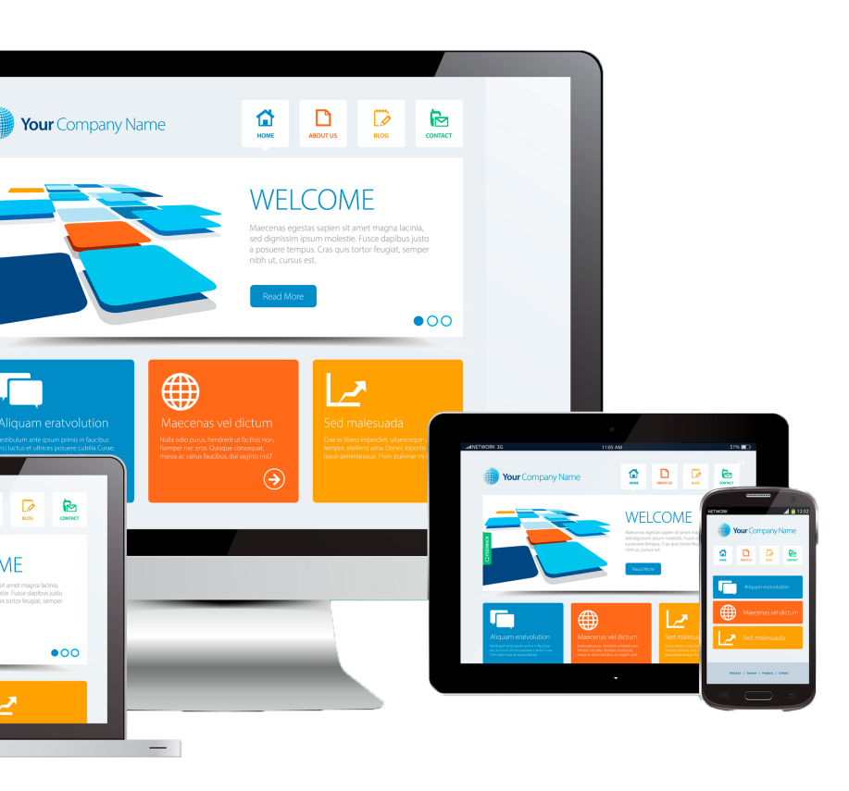
增加顧客消費類別 Build share of customer 例如: 銷售1個網站example: ONE WEBSITE SALE
銷售項目ITEM | 零售利潤RETAIL PROFIT | BV
網站銷售 WEBSITE SALE | HK$7,800 | 200 BV 30/ 每月
設計套裝 DESIGN PACKAGE |  | 50 BV
社群媒體管理SOCIAL MEDIA MANAGEMENT | HK$117/每月 | 20 BV/每月
優質臉書廣告PREMIUM FACEBOOK ADVERTISING | HK$79/每月 | 15 BV/每月
基本 GOOGLE廣告BASIC GOOGLE ADVERTISING | HK$185/每月 | 24 BV/每月
總銷售利潤TOTAL INITIAL SALE | HK$8,181 | 339 BV
總循環點數TOTAL RECURRING | HK$381/每月 | 89 BV/ 每月
*銷售金額將取決於產品項目，以及網站價值
* Sale prices will vary based on a variety of factors and how much value has been built into the site.

Slide 17
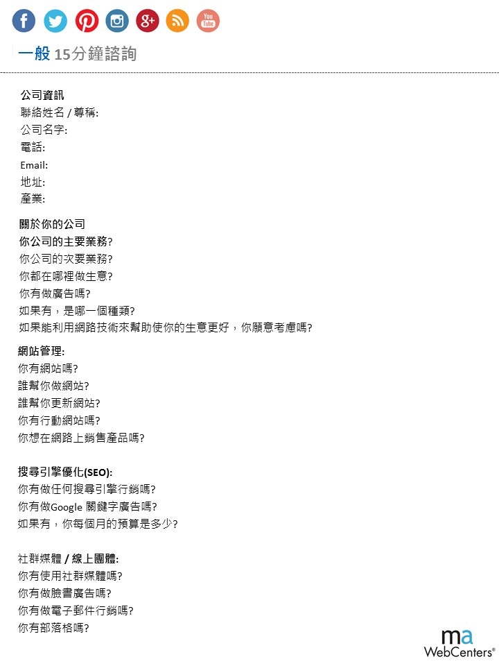
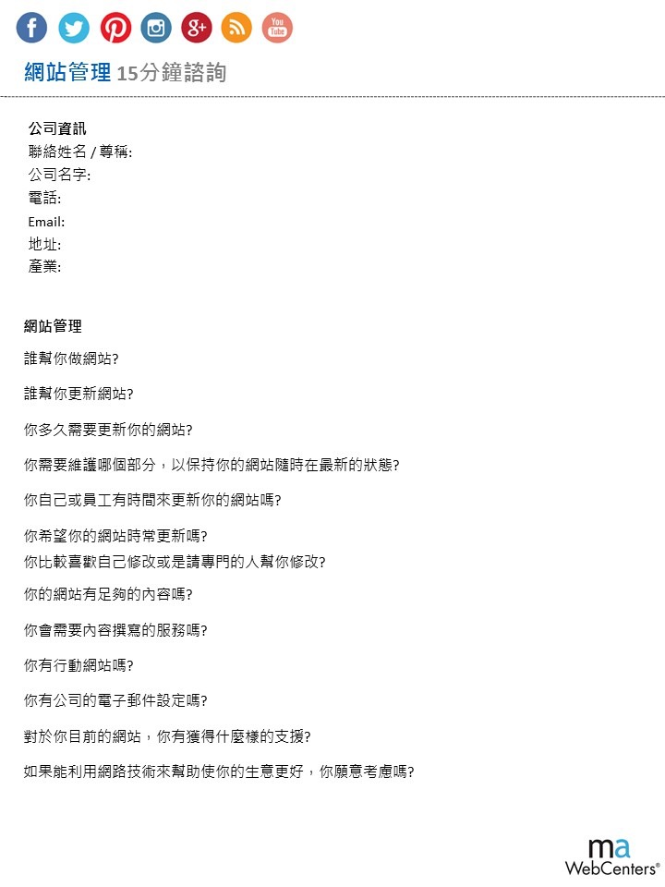
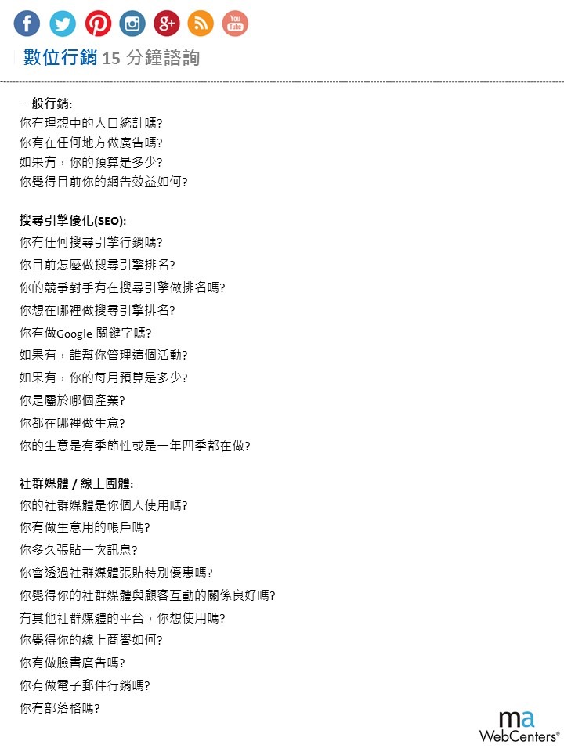
15分鐘諮詢表
15分鐘諮詢
15 Minutes Consultation

Slide 18
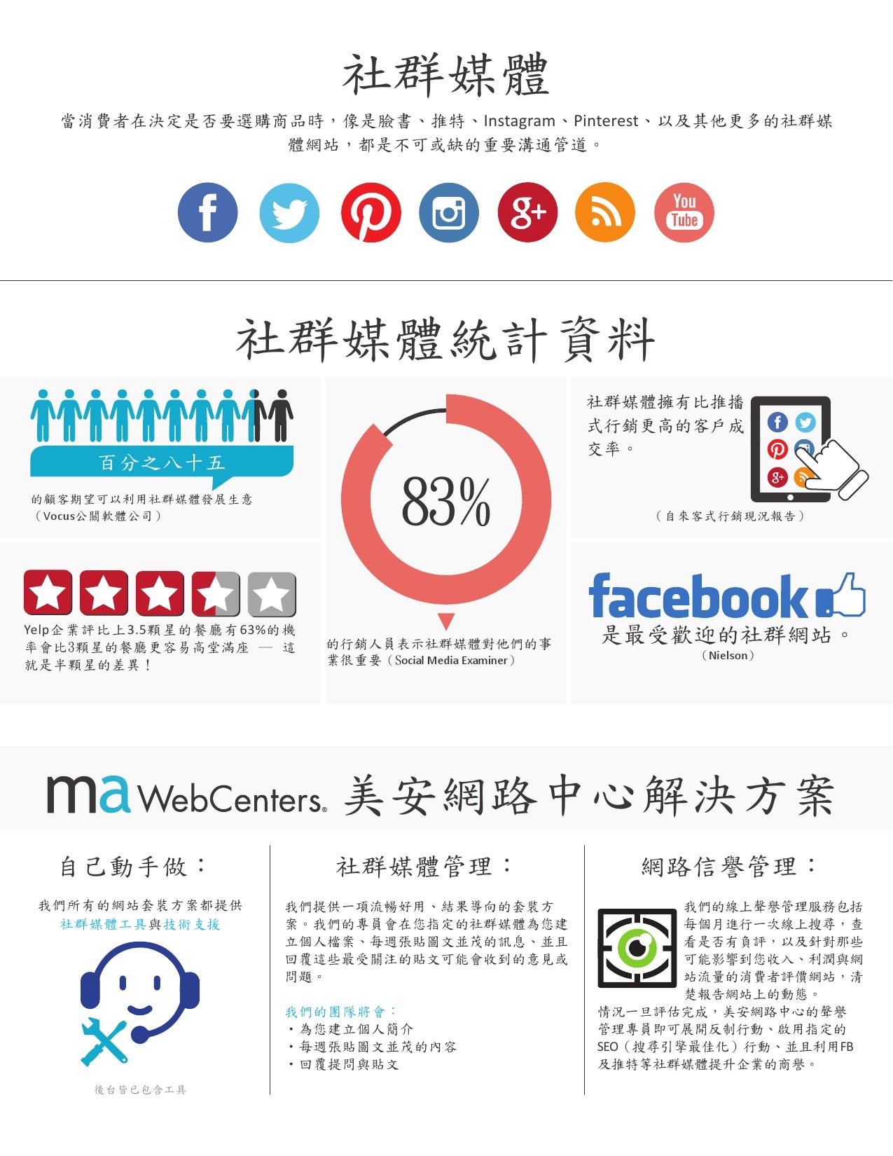
產品專員Product Specialist
顧客支援CUSTOMER SUPPORT
設計中心
SPECIAL TEAMS

Slide 19
如何利用競賽升級你的事業？
Leverage the Contest to develop your business
#WEBVOLUME CONTEST 4.0
網路中心積分競賽 4.0 將幫助你helps you:
銷售更多網站sell more websites
推薦更多超連鎖店主 recruit more UFOs
帶領更多夥伴參加2016年美安國際年會
Attend the MAIC2016 with more partners
銷售更多新產品! sell more new products!
WEBVOLUMECONTEST.COM

Slide 20
超值獎項!Prizes
首獎 1st Prize
二獎 2nd Prize
三獎 3rd Prize
獲勝團隊 Winning Team
價值$2,000美元的旅遊 - 美安公司的旅遊部門將協助首獎獲勝者預定含機票與 住宿的旅行假期,旅行相關費用最高可達$2,000美元。 1 Vacation valued up to $2,000. Market America's Travel department will assist in booking one vacation for the first place winner including airfare and accommodations not to exceed $2,000 USD
免費一年份網路中心代管 1 year of WebCenter fees
業務建立特別會議門票一張 1 Moving Up Seminar Ticket
2016美安國際大會門票兩張 2 tickets to International Convention 2016
2016美安國際大會VIP座位 VIP Seating at International Convention 2016
舞台與網路表揚 Stage and Online Recognition
價值$1,000美元的旅遊 - 美安公司的旅遊部門將協助二獎獲勝者預定含機票與住宿的旅行假期,旅行相關費用最高可達$1,000美元。 1 Vacation valued up to $1,000. Market America's Travel department will assist in booking one vacation for the first place winner including airfare and accommodations not to exceed $1,000 USD
免費6個月網路中心代管 6 months of WebCenter fees
2016美安國際大會門票兩張 2 tickets to International Convention 2016
2016美安國際大會VIP座位 VIP Seating at International Convention 2016
舞台與網路表揚 Stage and Online Recognition
價值$500美元的旅遊 - 美安公司的旅遊部門將協助三獎獲勝者預定含機票與住宿的旅行假期,旅行相關費用最高可達$500美元。 1 Vacation valued up to $500. Market America's Travel department will assist in booking one vacation for the first place winner including airfare and accommodations not to exceed $500 USD
免費3個月網路中心代管 3 months of WebCenter fees
2016美安國際大會門票兩張 1 tickets to International Convention 2016
2016美安國際大會VIP座位 VIP Seating at International Convention 2016
舞台與網路表揚 Stage and Online Recognition
2016國際大會VIP午餐一份 1 VIP Lunch at International Convention 2016
與JR Ridinger會面 1 Meet and Greet with JR Ridinger
WEBVOLUMECONTEST.COM

Slide 21
weBVolume 競賽
是設計來幫助您以網路中心經營者的身分,發展一份成功的超連鎖事業,參賽者將被指派至一個負責團隊,並能參加我們的每週網路研討會,會中將把重心放在網路中心的銷售與招募,您將可同時參加並贏取個人和團隊獎項。
The weBVolume contest
is designed to help you grow a successful UnFranchise as a WebCenter Owner. Participants will be assigned an accountability team, and be able to participate in our weekly webinar series, which focuses on selling and recruiting in the WebCenter division. They will also be entered to win individual and team prizes.
競賽規則總覽 Overview of Contest Rules
個人獎項將頒給在挑戰期間獲得最多點數的參賽者。 Individual Prizes will be awarded to Participants who earn the most points during the Challenge Period.
成績 | 獲得點數 Achievement | Points Awarded
完成網站會談 (銷售行事曆) | 25 Complete Website Appointment (Sales Calendar) | 25
完成數位行銷產品會談 (銷售行事曆) | 25 Complete DMP Appointment (Sales Calendar) | 25
網站銷售 | 100 Website Sale | 100
DMP Sale | 100
個人贊助 | 100 Personally Sponsored | 100
主要活動門票 | 25 Ticket to Major Event | 25
參加網路中心訓練 | 25 Attend WCT | 25
SHOP Local Partner | 50
提交報告 | 10 Submit Report | 10
達成網路中心挑戰 | 200 Achieve the WebCenter Challenge | 200
成績 | 比重 Achievement | Weight
全部參與的參賽者 | 25% Total Engaged Participants | 25%
全部銷售 | 25% Total Sales | 25%
全部新Shop當地企業 | 10% Total New Shop Local Businesses | 10%
全部個人贊助 | 20% Total Personally Sponsored | 20%
全部主要活動門票 (MAIC2016) | 10% Total Tickets to Major Event (MAIC2016) | 10%
全部參加的網路中心訓練| 10% Total WCTS Attended | 10%
團隊獎項將頒給在挑戰期間獲得最多點數的參賽團隊。 The Winning Team will be awarded to the Team who earns the highest score during the Challenge Period.
WEBVOLUMECONTEST.COM

Slide 22
全新教育訓練手冊 The new training handbook
我們為你製作12週的訓練計畫!
所有的課程內容設計，都是為了協助你拓展所有的潛在機會、分享銷售技巧、加強銷售品質以及讓你贏得競賽!
We made the 12-week training program for you!
All contents are intended to help you expand all potential opportunities, share sales skills, enhance quality and make you win the Contest!
資源 Resources
幫助起步的工具 Start-up Kit
網路中心經營者支援 maWebCenter Owner Support
銷售支援 Sales Support
12- 周課表 12-week Training
在mawc411.com有簡短影片Short videos on mawc411.com
每周練習 Practice every week
跟進Follow
評量 Assessment
進度 Progress
成果 Result
修正 Adjustment
WEBVOLUMECONTEST.COM

Slide 23
現在就參加 #WEBVOLUME 4.0 競賽
報名網站Where: WWW.WEBVOLUMECONTEST.COM
競賽日期When: 2月29日, 2016 – 6月17日,2016
報名費Application fee: 美金10元
下載你的競賽手冊 Download your Contest Handbook
註冊研討會課程 Resigter trainings
加入我們一起贏得成功!
Gain the success with the Contest and with us!
網路中心中文積分競賽活動 即將展開!
The WebCenter Contest is coming soon!

Slide 24
大會優惠
＃MHKLS2016 Special Offer
網路中心WebCenter: HK$2,730 / 300 BV
3 張2016美安香港領袖訓練會議門票
(mhk Leadership Conference)
開通你的網路中心!
Get your WebCenter NOW!
啟動你的網路中心
Activate your WebCenter
* 網路中心管理費仍需按月收取

Slide 25
新產品 新願景 新商機
New Product New Vision
New Opportunity

